Slide 1
Tuesday, January 17, 2017
Write In Your Agenda:
Write In Your Monitoring Log:
CW:
Learn to use “Ms. Nerg” to define Ecology.
HW:
None.
Response to Warm-Up:
What is Ecology? What does it mean to you?
You will need:
Pencil
New Monitoring Log

Slide 2
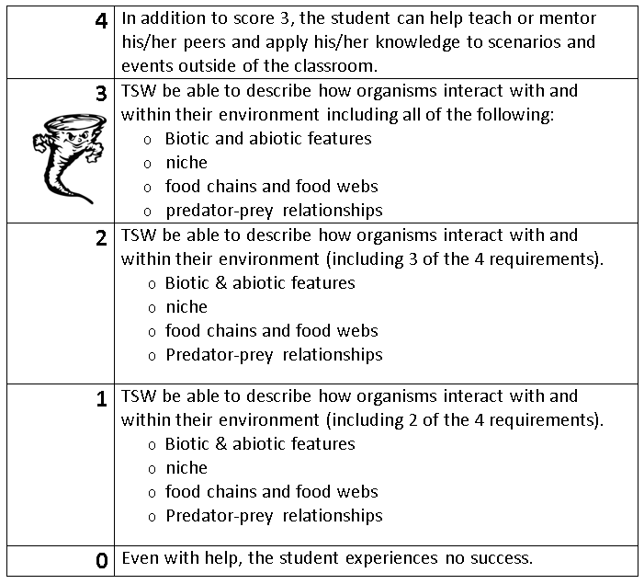
Learning Goal and Scale
TSW be able to describe how organisms interact with and within their environment (including biotic and abiotic features, niche, food chains & webs, and predator-prey relationships).

